Slide 1
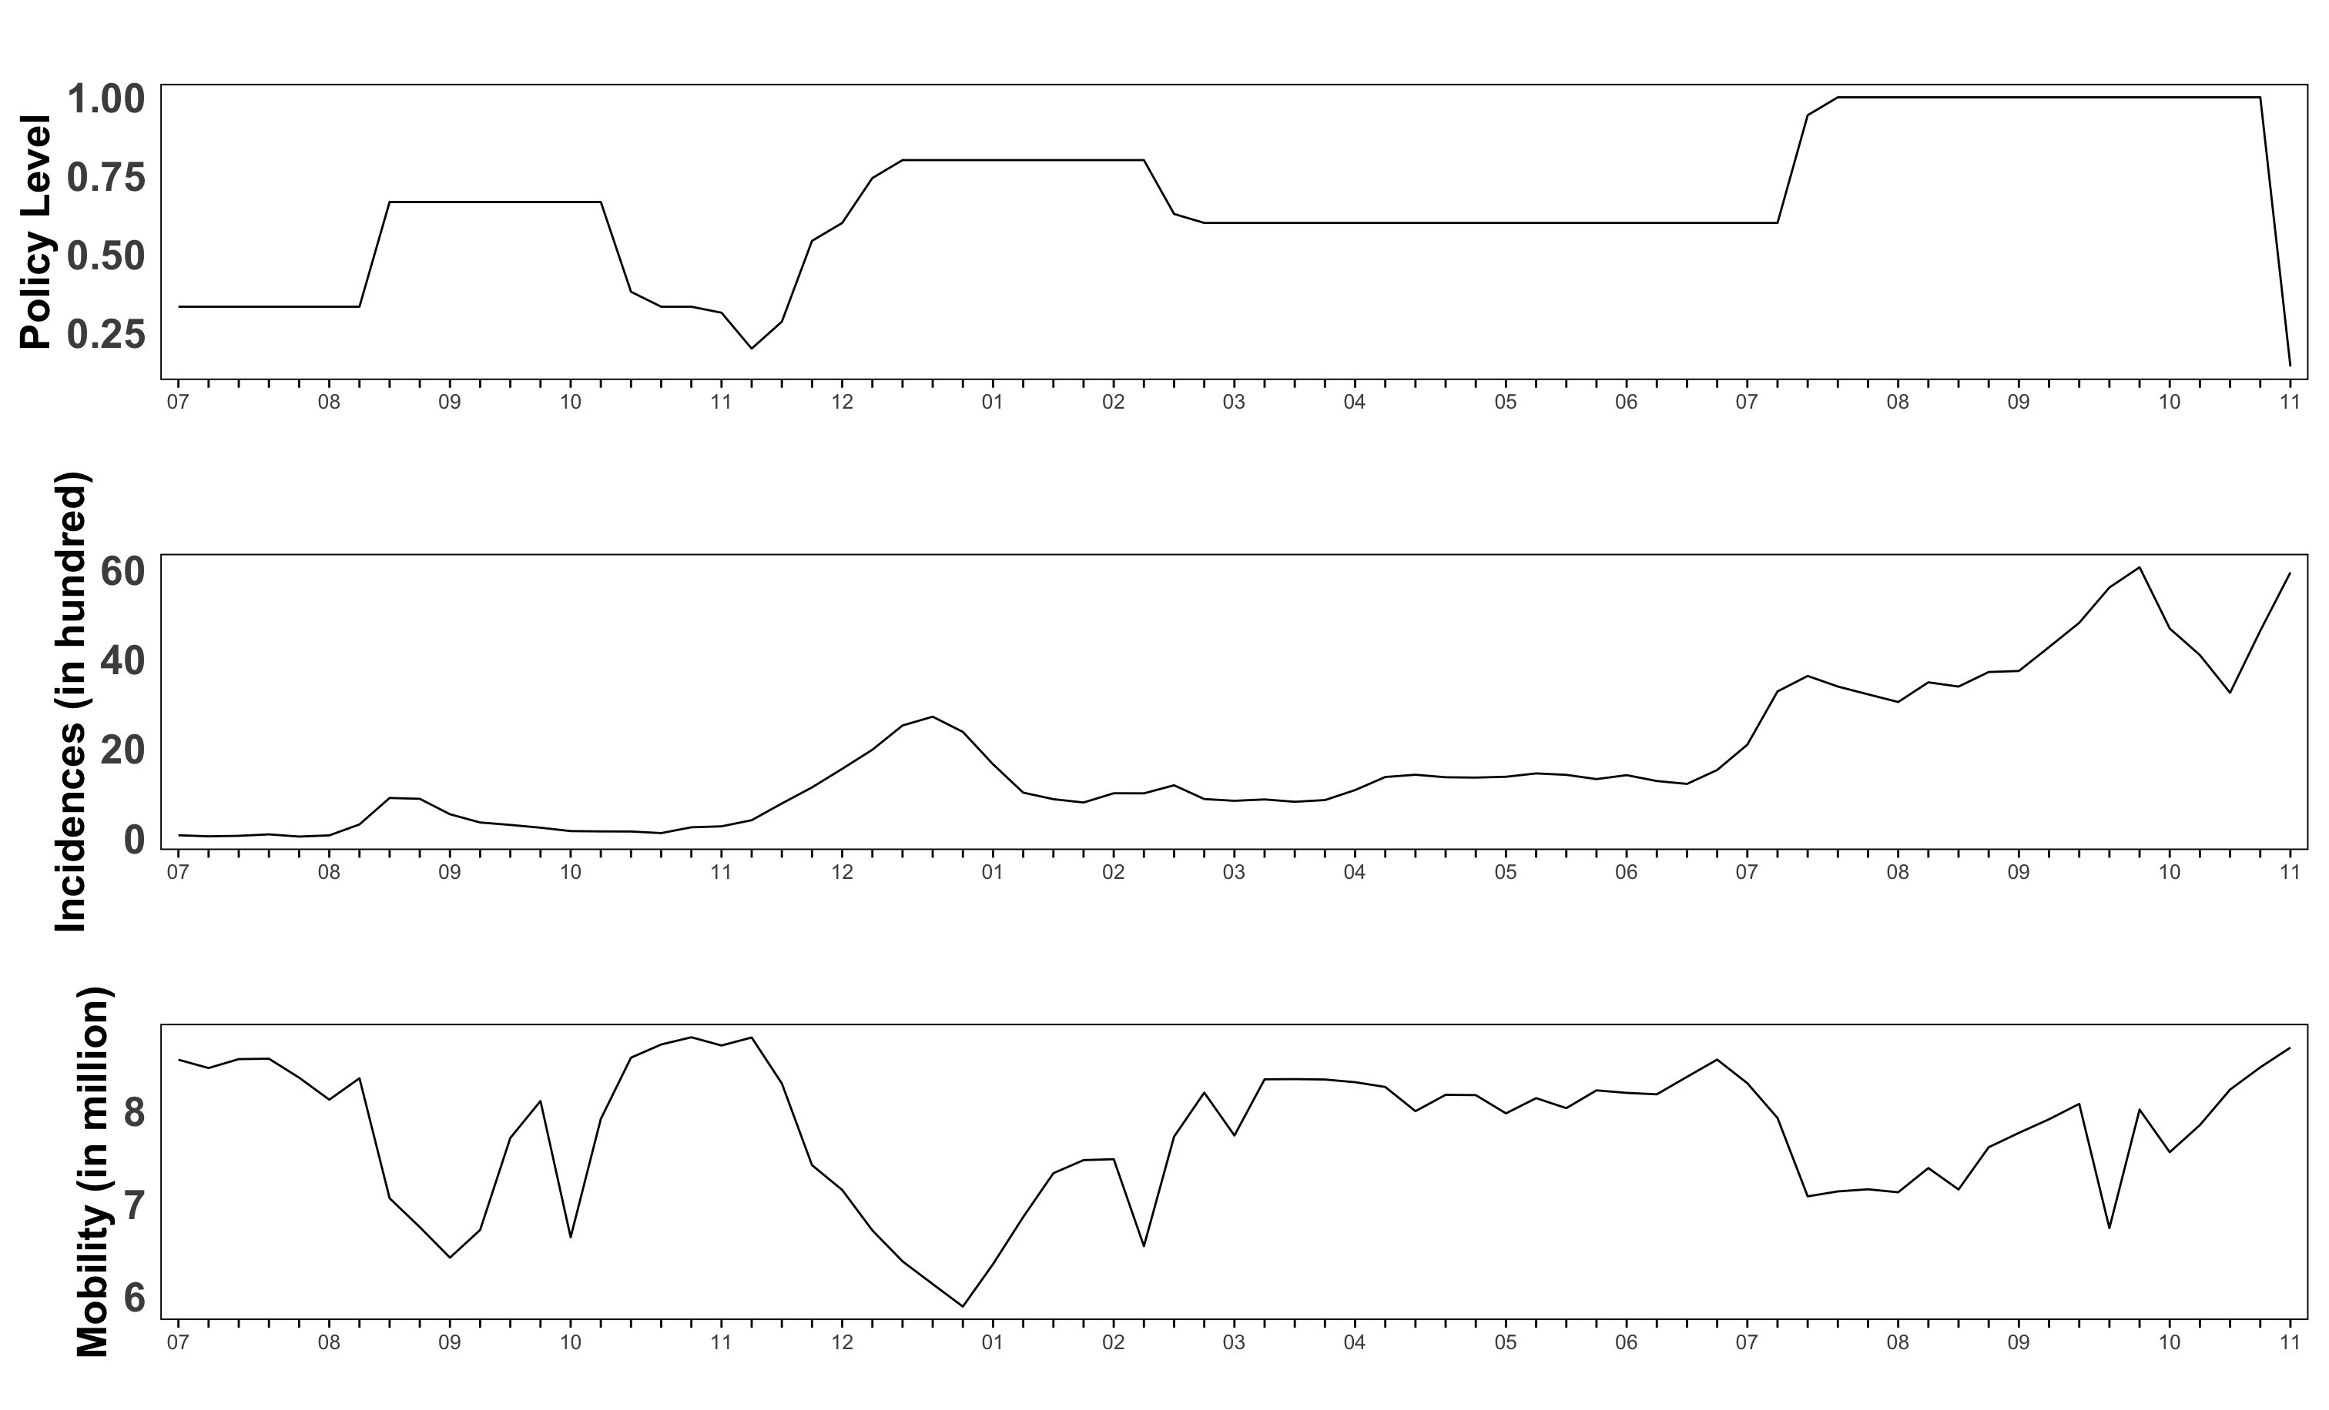
2020
2021
3rd peak
2nd peak
4th peak
2020
2021
2020
2021

Slide 2
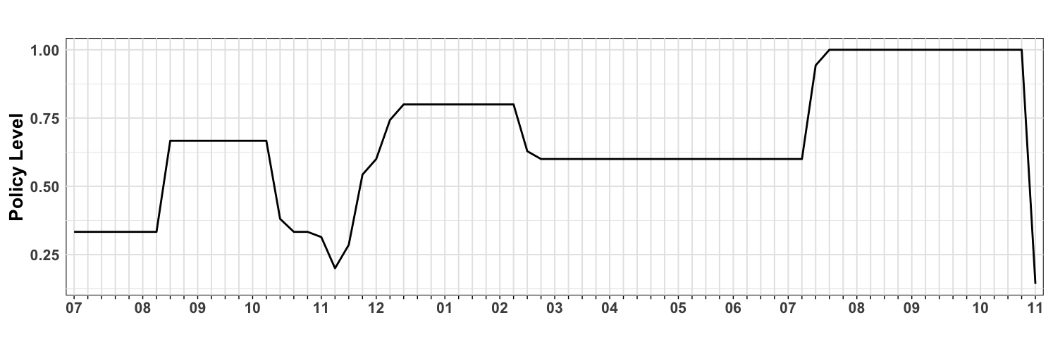
1st wave
2nd wave
3rd wave
4th wave
Prohibit 50+ indoor/100+ outdoor
Only non-face-to-face worship
Level 2/3
Cessation of theaters and stores after 21:00
Prohibit 5+ gathering during New Year holidays
Adjust to level 4/5
Step by step daily recovery
Adjust to level 3/5
Distancing in daily life for metropolitan area.
Level 1/3
Prohibit 4+ gathering before 18:00, after that only 2 allowed
Restrict private activities at entertainment facilities, operate public facilities until 22:00
Apply reformed level 4/4
Adjust to level 1/3
Prohibit 500+ gathering
Apply reformed level 1/5
Adjust to level 3/5
Reinforcement of diagnostic tests
Only take-out & delivery allowed at restaurants
Prohibit indoor learning and recreational spaces
Only non-face-to-face classes allowed
Adjust to level 2/5
2020
2021

